Slide 1
Types Of Wind Turbines, Wind Farms, Wind Generation And Control
SlideMake.com

Slide 2
Types of Wind Turbines
Horizontal-axis wind turbines are the most common type, with blades that rotate around a horizontal axis.
Vertical-axis wind turbines have blades that rotate around a vertical axis, allowing them to capture wind from any direction.
Other types include offshore wind turbines, which are built in bodies of water, and small-scale turbines for residential use.
Notes:
Image source: https://www.researchgate.net/figure/Different-Types-of-Horizontal-Axis-Wind-Turbine-5_fig4_277721670

Slide 3
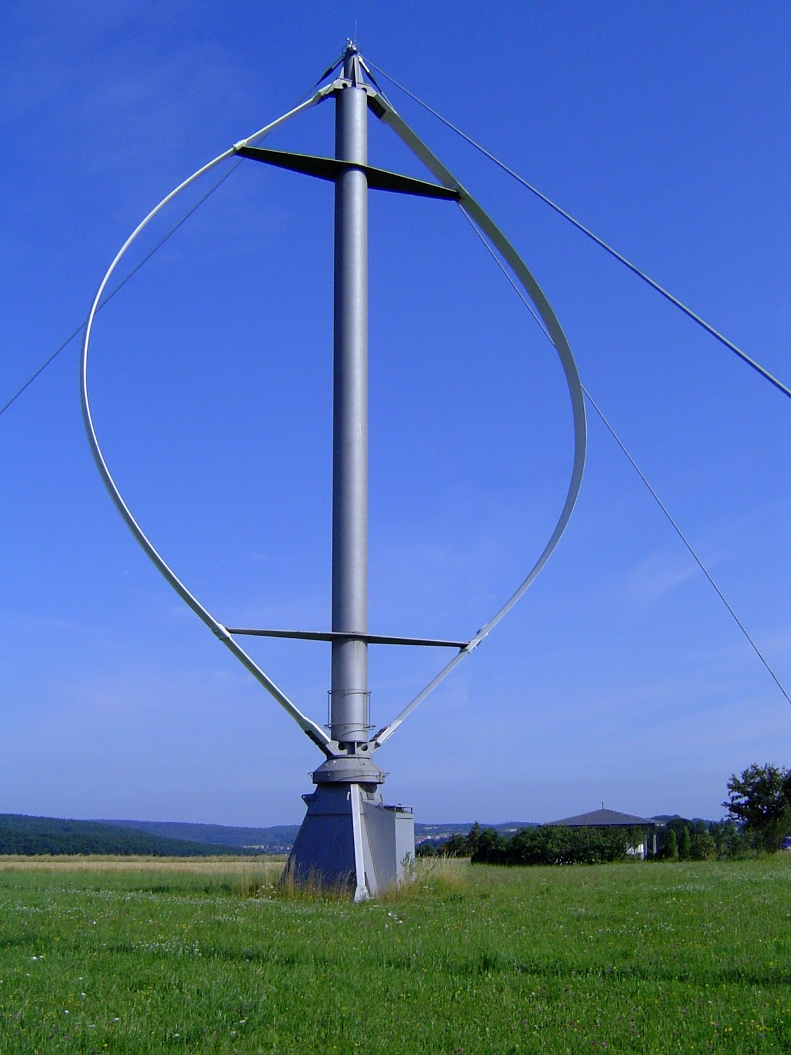
Horizontal-Axis Wind Turbines
Horizontal-axis wind turbines are the most widely used type of wind turbine.
They have a tall tower that supports a rotor with three blades.
The rotor spins when wind hits the blades, converting the kinetic energy into mechanical energy.
Notes:
Image source: https://www.mechanicalbooster.com/2017/01/types-of-wind-turbines.html

Slide 4
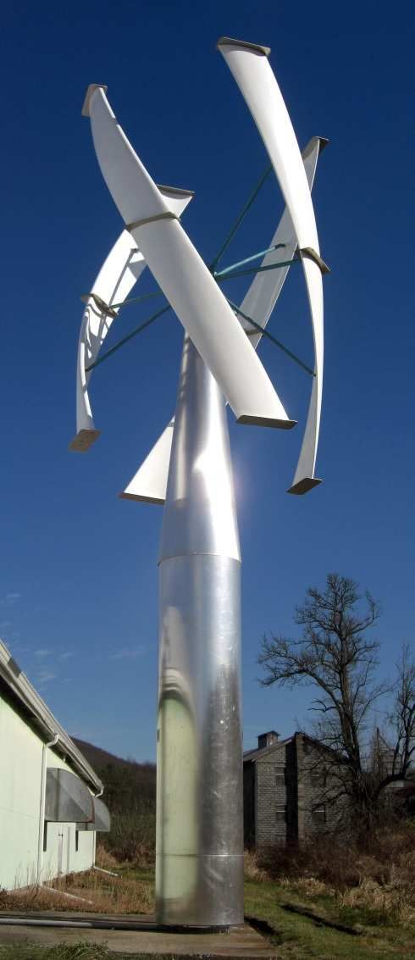
Vertical-Axis Wind Turbines
Vertical-axis wind turbines have blades that are arranged vertically.
They are suitable for areas with changing wind directions.
Vertical-axis turbines have a lower noise level and are easier to maintain compared to horizontal-axis turbines.
Notes:
Image source: https://www.pinterest.com.au/pin/493496071646748451/

Slide 5
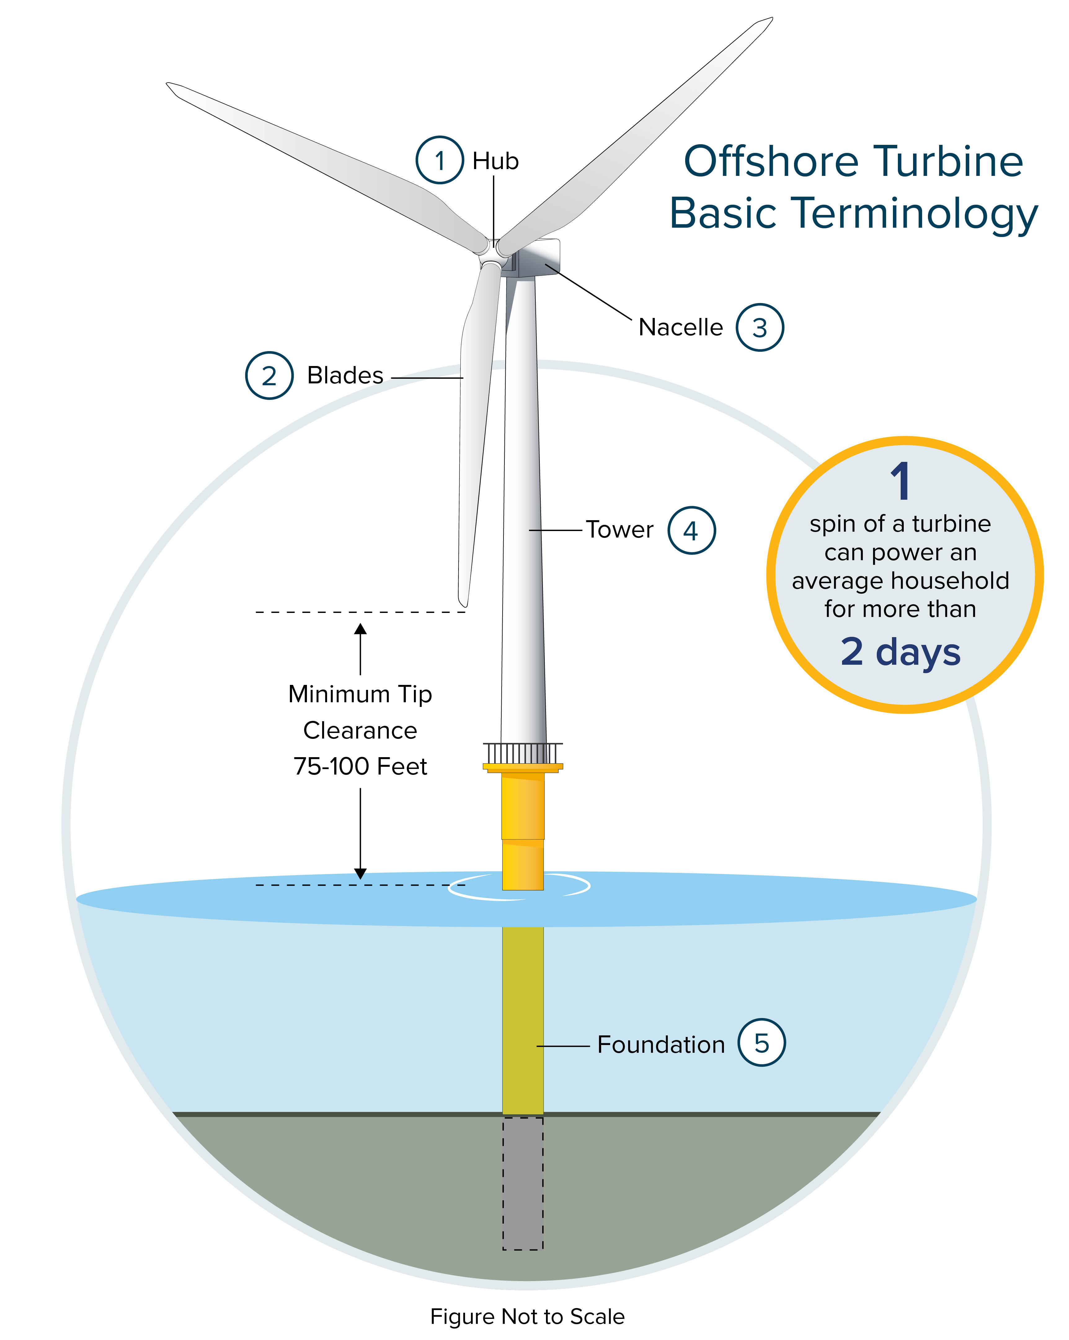
Offshore Wind Turbines
Offshore wind turbines are installed in bodies of water, typically in coastal areas.
They have larger blade lengths and higher capacity compared to onshore turbines.
Offshore wind turbines can take advantage of stronger and more consistent winds.
Notes:
Image source: https://www.nyserda.ny.gov/All-Programs/Offshore-Wind/About-Offshore-Wind/Offshore-Wind-101

Slide 6
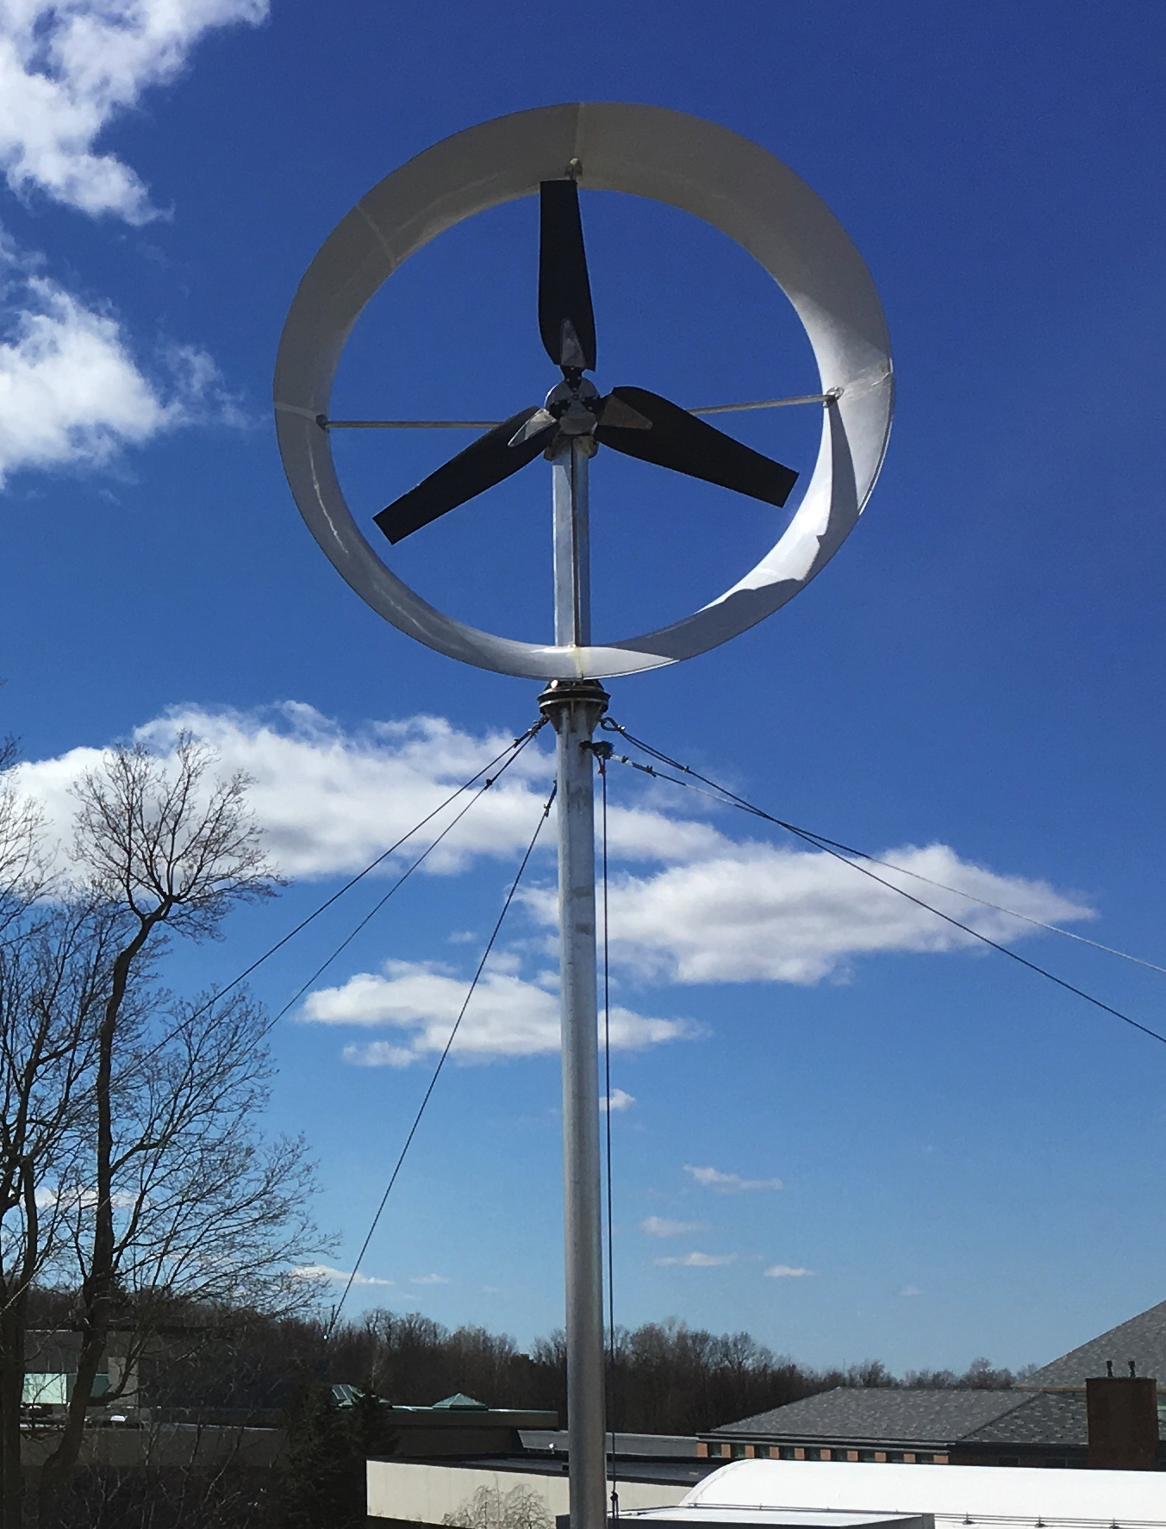
Small-Scale Wind Turbines
Small-scale wind turbines are designed for residential or small commercial use.
They can be mounted on rooftops or standalone towers.
Small-scale turbines are an excellent option for individuals or communities looking to generate their own renewable energy.
Notes:
Image source: http://www.ductedwind.com/technology/commercial-specifications

Slide 7
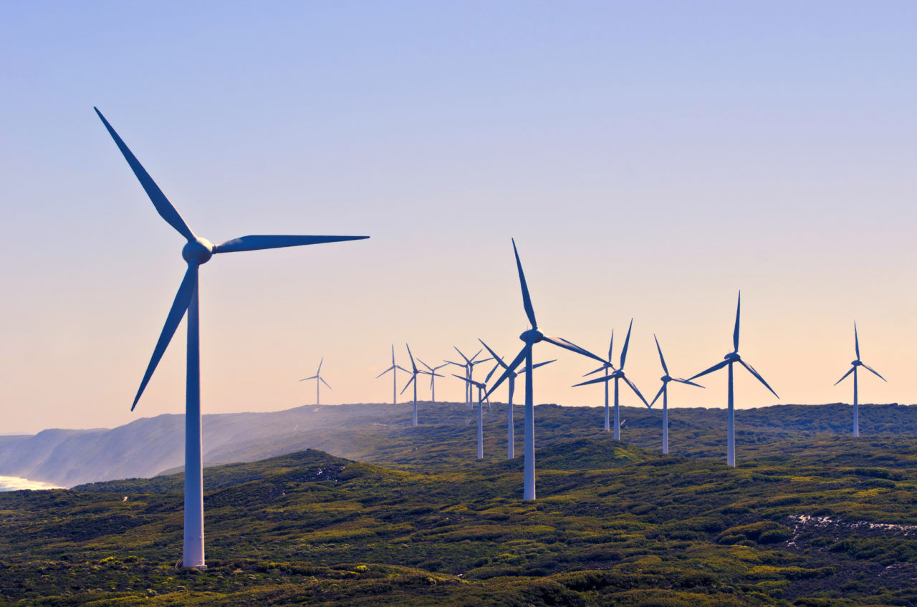
Wind Farms
A wind farm is a collection of wind turbines in the same location.
Wind farms are strategically placed in areas with high wind resources.
They can range in size from a few turbines to hundreds of turbines.
Notes:
Image source: https://utilligent.com/news-and-events/sap-for-utilities/wind-turbines-on-a-wind-farm-albany-western-australia-australia/

Slide 8
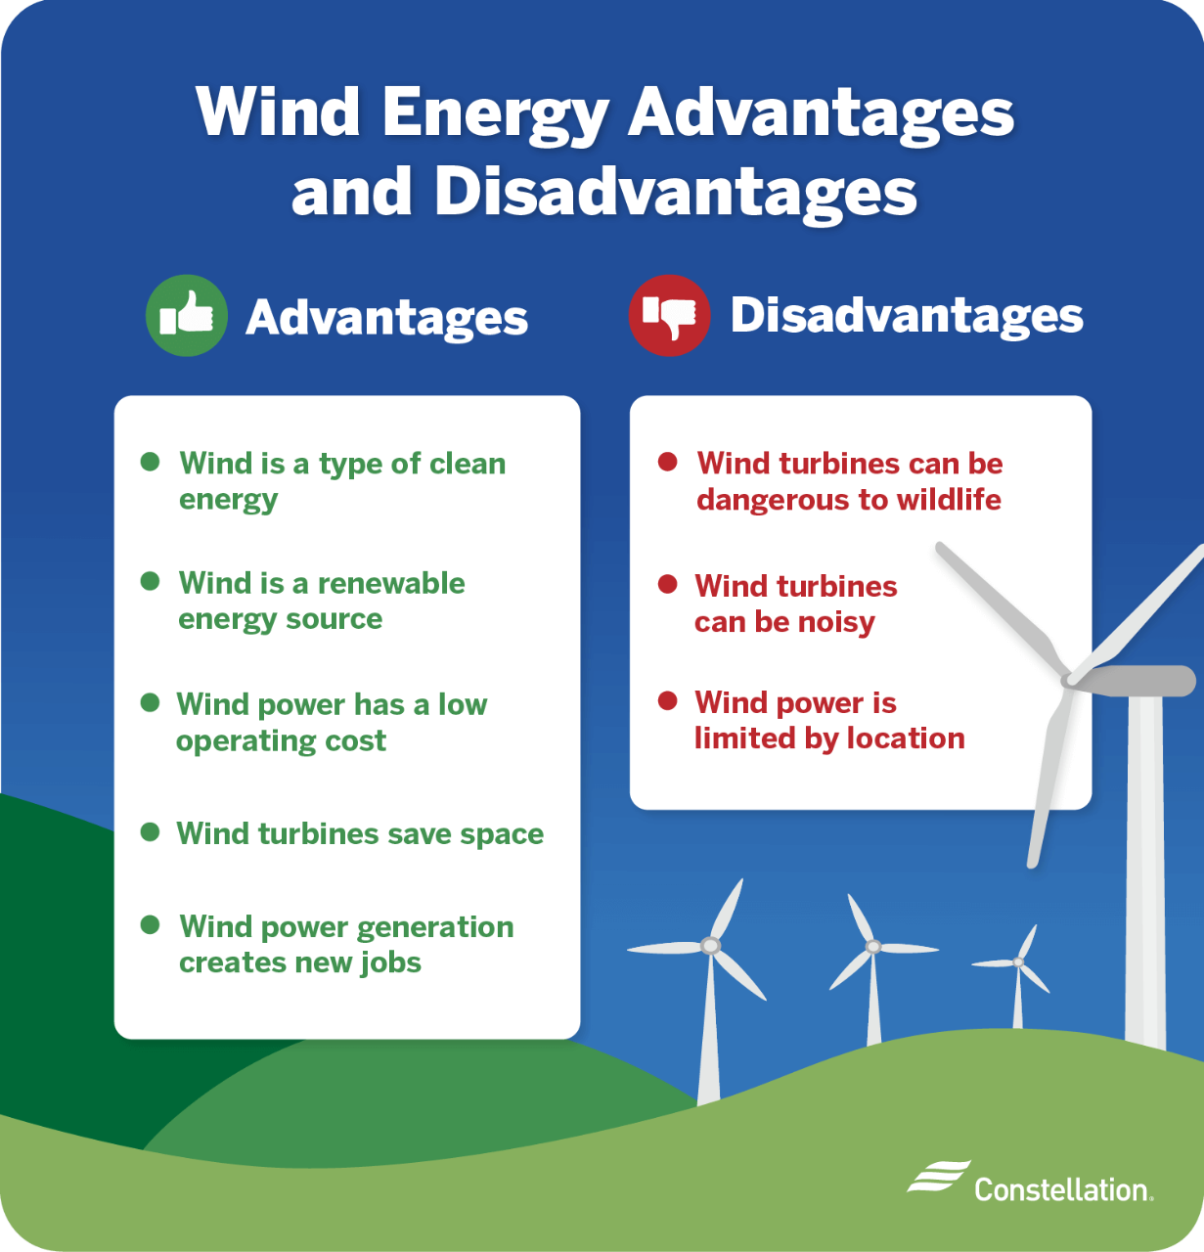
Benefits of Wind Farms
Wind farms generate clean, renewable energy without producing greenhouse gas emissions.
They contribute to energy independence by reducing reliance on fossil fuels.
Wind farms create jobs and stimulate local economies through construction and maintenance activities.
Notes:
Image source: https://www.constellation.com/energy-101/energy-innovation/wind-energy-pros-cons.html

Slide 9
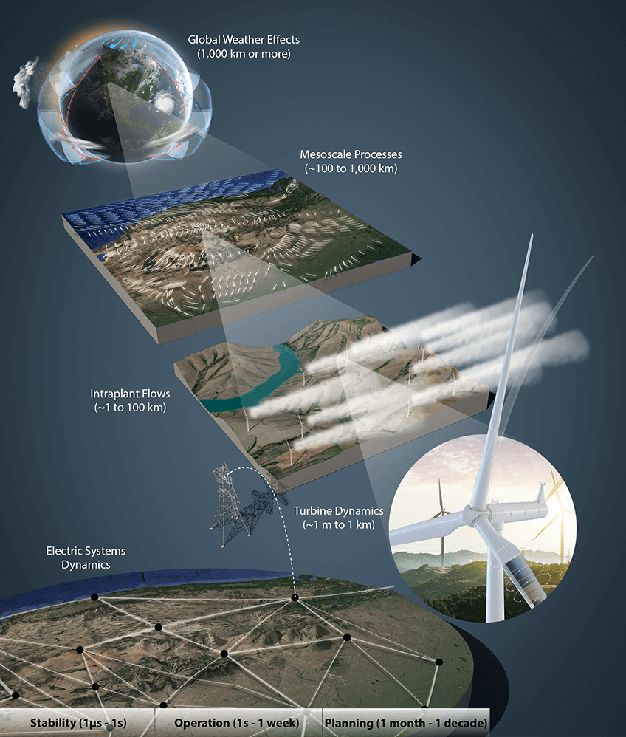
Challenges of Wind Farms
Wind farms can face opposition from communities due to visual and noise impacts.
They require careful planning and consideration of environmental factors.
Transmission infrastructure is necessary to connect wind farms to the electrical grid.
Notes:
Image source: https://www.nrel.gov/news/program/2019/nrel-publishes-science-journal-article-posing-three-challenges-to-wind-energy-potential.html

Slide 10
Wind Generation
Wind generation refers to the process of converting wind energy into electrical energy.
Wind turbines use the kinetic energy of the wind to rotate the rotor, which drives a generator.
The generator produces electricity that can be used to power homes, businesses, and industries.
Notes:
Image source: https://mavink.com/explore/Wind-Turbine-Flow-Diagram

Slide 11
Wind Generation Advantages
Wind generation is a renewable energy source that does not deplete natural resources.
It helps reduce greenhouse gas emissions and combat climate change.
Wind generation provides energy security and price stability by diversifying the energy mix.
Notes:
Image source: https://www.constellation.com/energy-101/energy-innovation/wind-energy-pros-cons.html

Slide 12
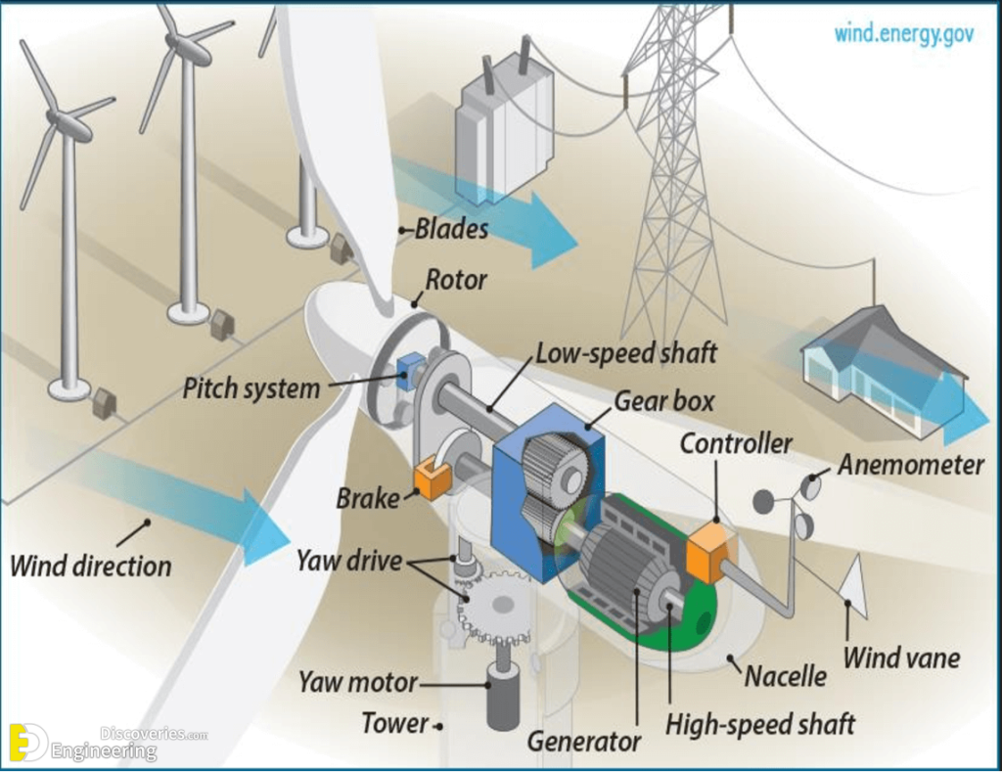
Wind Generation Challenges
Wind generation is intermittent, as it depends on wind availability.
Energy storage systems are required to ensure a stable supply of electricity.
Challenges in integrating wind generation into the grid must be addressed to maintain system stability.
Notes:
Image source: https://engineeringdiscoveries.com/what-is-a-wind-turbine-and-how-it-works/windmill_900_v1/

Slide 13
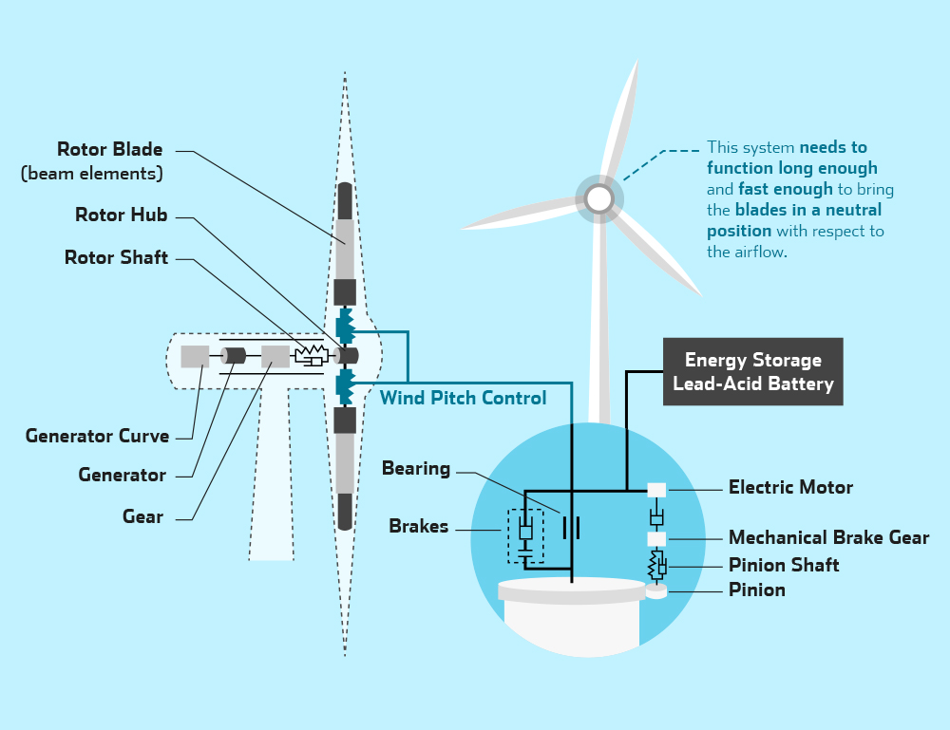
Control Systems in Wind Turbines
Control systems in wind turbines monitor and regulate various parameters to optimize performance.
Pitch control adjusts the angle of the blades to control the rotor speed and power output.
Active yaw control allows turbines to align with the wind direction, maximizing energy capture.
Notes:
Image source: http://www.skeletontech.com/wind-turbine-pitch-control

Slide 14
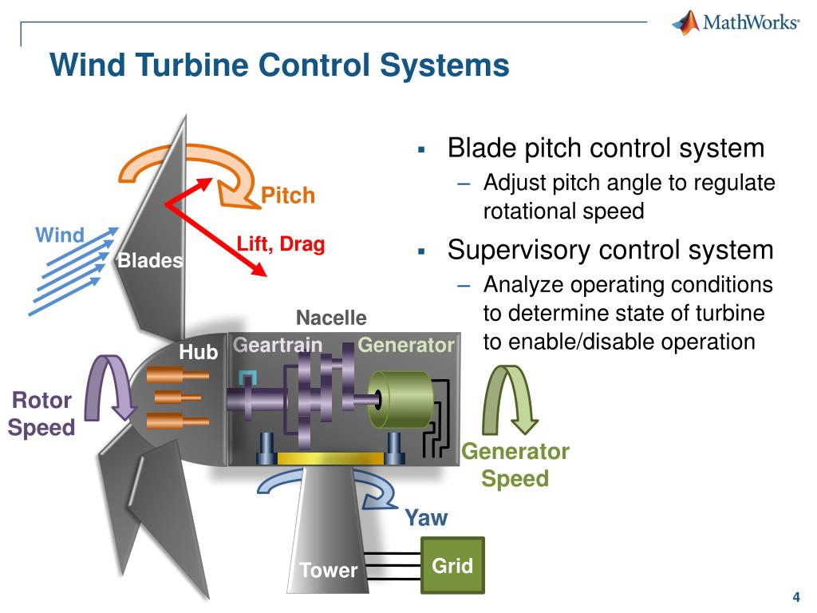
Control Systems in Wind Turbines (contd.)
Reactive power control maintains voltage stability and ensures grid compatibility.
Active power control adjusts the turbine's power output to match the grid's demand.
Supervisory control systems monitor and coordinate the operation of multiple turbines in a wind farm.
Notes:
Image source: https://www.slideserve.com/onan/designing-control-systems-for-wind-turbines

Slide 15
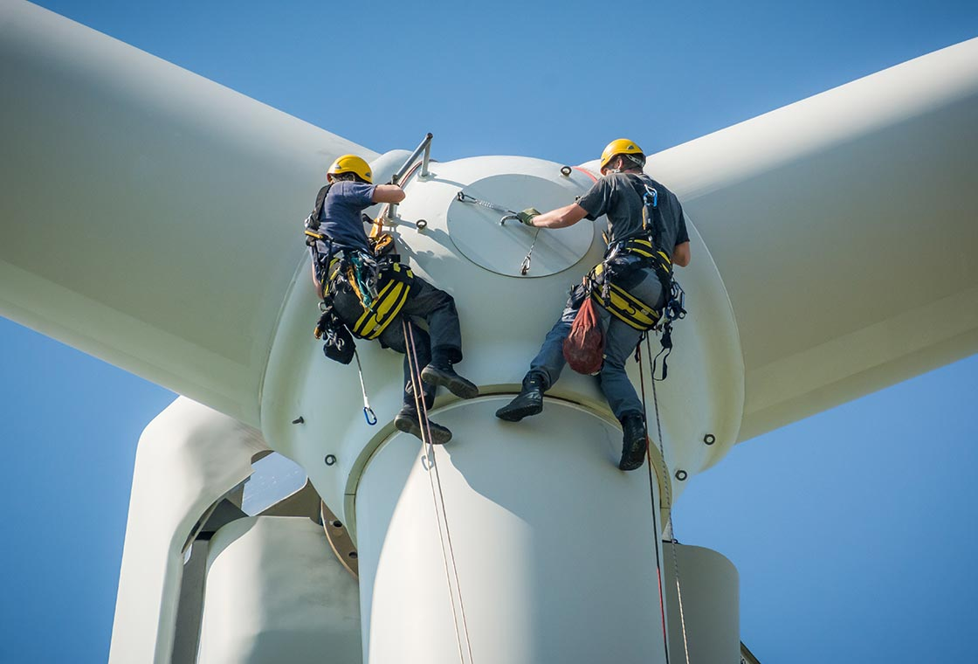
Wind Turbine Operations and Maintenance
Regular maintenance is essential to ensure the efficient and reliable operation of wind turbines.
Inspections, lubrication, and component replacements are part of routine maintenance.
Remote monitoring systems allow for real-time performance tracking and early detection of issues.
Notes:
Image source: https://www.rts-wind.co.uk/services/service-operations-maintenance/

Slide 16
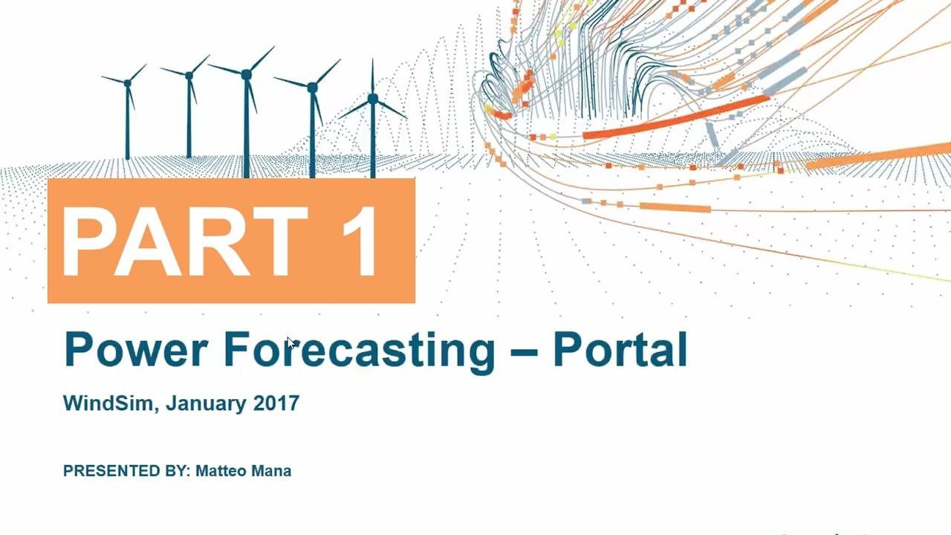
Wind Power Forecasting
Wind power forecasting uses weather data and mathematical models to predict wind energy production.
Accurate forecasting helps grid operators manage the integration of wind power into the system.
It enables efficient scheduling of conventional power plants and energy storage resources.
Notes:
Image source: https://www.youtube.com/watch?v=a5UcmKDdJGE

Slide 17

Environmental Considerations
Wind farms must consider potential impacts on wildlife, such as birds and bats.
Proper site selection and turbine design can minimize these impacts.
Studies and monitoring are conducted to understand and mitigate environmental risks.
Notes:
Image source: https://fdocuments.in/document/ecological-impacts-of-wind-farms-global-national-wind-turbines-can-kill-birds.html

Slide 18
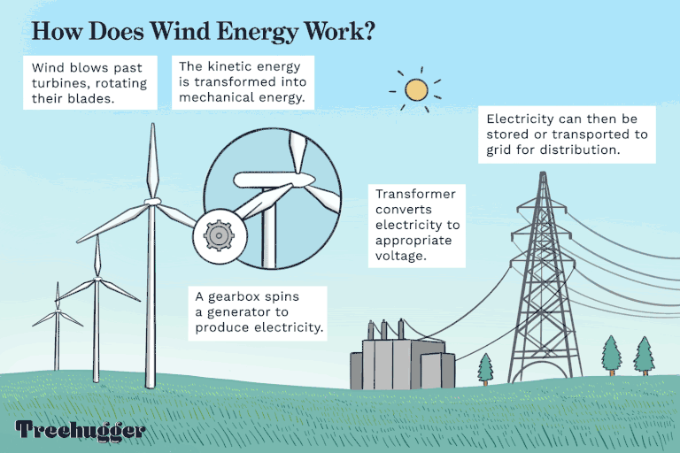
Wind Power and Energy Transition
Wind power plays a crucial role in transitioning to a low-carbon and sustainable energy future.
It complements other renewable energy sources like solar and hydropower.
Continued research and innovation are needed to enhance efficiency and reduce costs.
Notes:
Image source: https://blog.strive2thrive.earth/what-is-wind-energy-advantages-and-disadvantages/

Slide 19
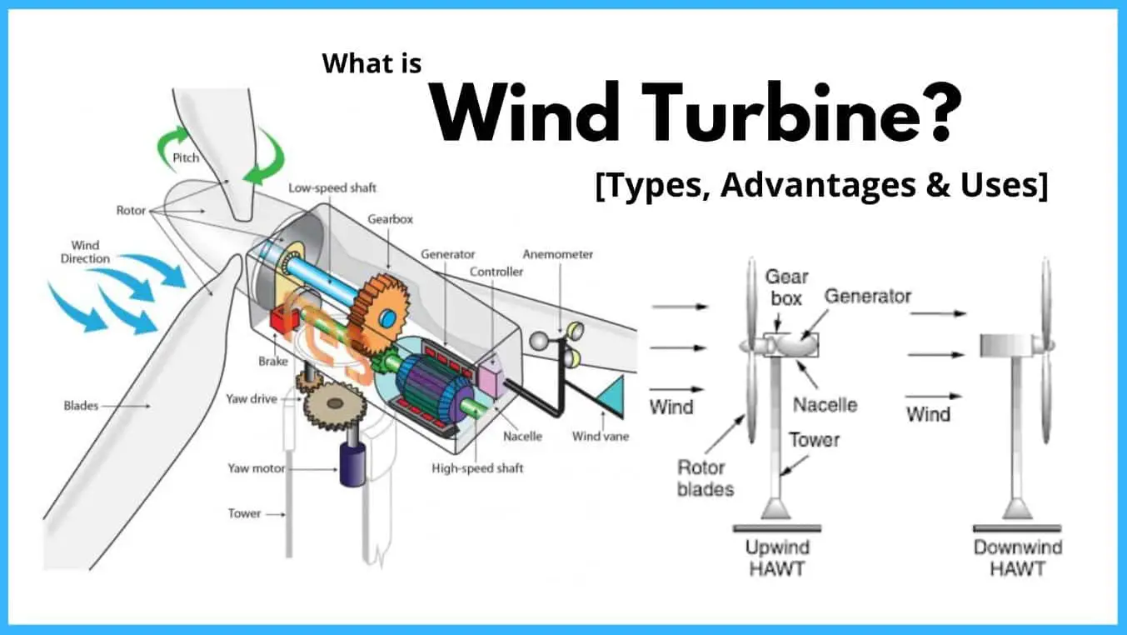
Conclusion
Wind turbines come in various types, including horizontal-axis, vertical-axis, offshore, and small-scale turbines.
Wind farms harness wind energy to generate clean electricity on a larger scale.
Control systems and maintenance ensure optimal performance and reliability.
Notes:
Image source: https://www.theengineerspost.com/types-wind-turbine-horizontal-vertical/

